Slide 1
2015
Computer Vision

Slide 2
ImageNet 2015
1st Place in Classification
1st Place in Detection
1st Place in Localization
Top-5 error: 3.57%
From 6.67%
Computer Vision

Slide 3
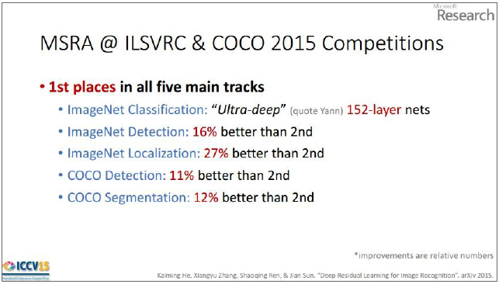
Residual Network
[He et al., 2015, 2016]
Computer Vision
Notes:
ILSVRC 2015 winner (3.6% top 5 error)
Slide from Kaiming He’s recent presentation https://www.youtube.com/watch?v=1PGLj-uKT1w

Slide 4
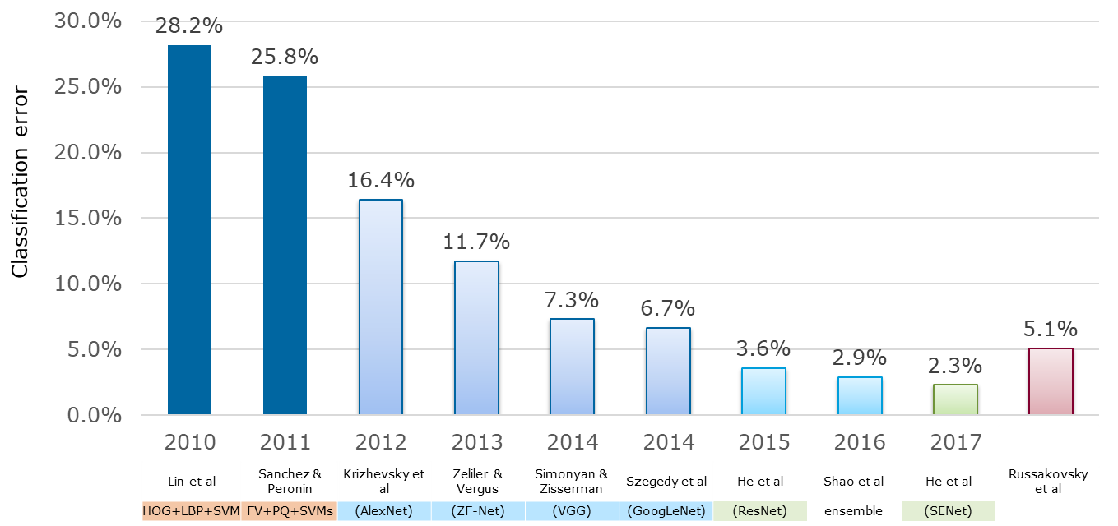
ImageNet Large Scale Visual Recognition Challenge (ILSVRC) Winners
“Revolution of Depth”
152 layers
152 layers
152 layers
19 layers
22 layers
shallow
8 layers
8 layers
Computer Vision

Slide 5
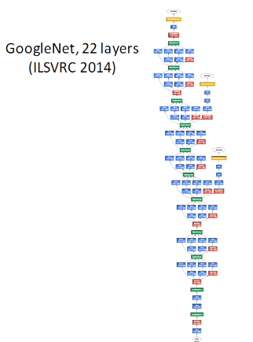
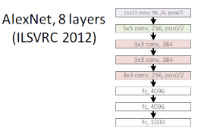
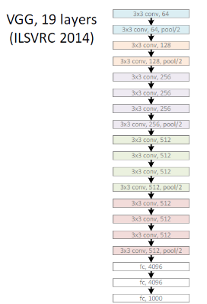
Revolution of Depth
Computer Vision

Slide 6
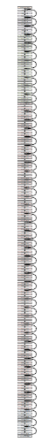
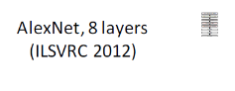
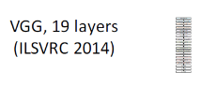
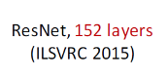
Revolution of Depth
“ULTRA-DEEP” Network
2-3 weeks of training on 8 GPU machine
at runtime: faster than a VGGNet!
(even though it has 8x more layers)
Computer Vision
Notes:
ILSVRC 2015 winner (3.6% top 5 error)
Slide from Kaiming He’s recent presentation https://www.youtube.com/watch?v=1PGLj-uKT1w

Slide 7
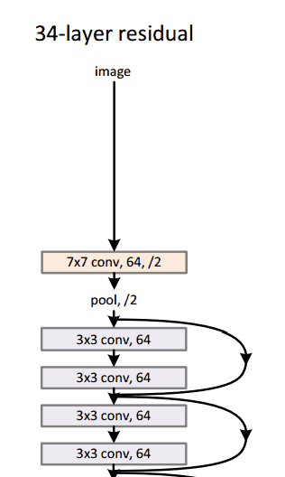
Revolution of Depth
“ULTRA-DEEP” Network
2-3 weeks of training on 8 GPU machine
at runtime: faster than a VGGNet!
(even though it has 8x more layers)
Computer Vision
Notes:
ILSVRC 2015 winner (3.6% top 5 error)
Slide from Kaiming He’s recent presentation https://www.youtube.com/watch?v=1PGLj-uKT1w

Slide 8
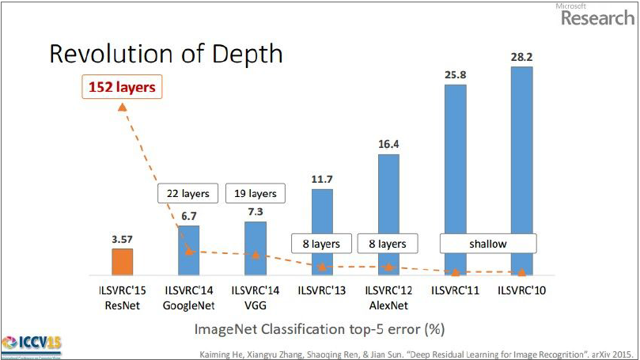
[He et al., 2015, 2016]
Computer Vision
Notes:
ILSVRC 2015 winner (3.6% top 5 error)
Slide from Kaiming He’s recent presentation https://www.youtube.com/watch?v=1PGLj-uKT1w

Slide 9
Is learning better networks as simple as stacking more layers?
Computer Vision

Slide 10
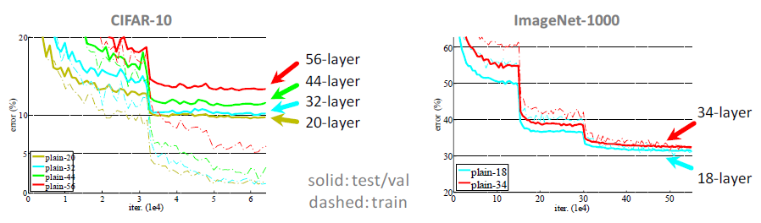
Do not simply stacking layers (!)
“Overly deep” plain nets have higher training error
Pain nets: stacking 3x3 conv layers
[He et al., 2015, 2016]
Computer Vision
Notes:
general phenomenon, observed in many datasets

Slide 11
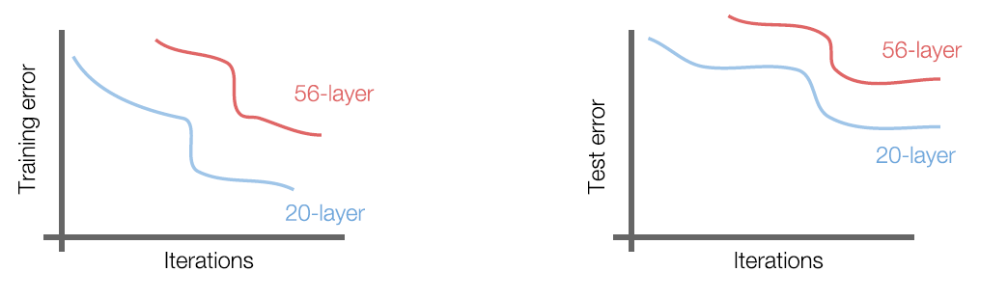
Do not simply stacking layers (!)
But it’s not caused by overfitting!
[He et al., 2015, 2016]
Computer Vision
Notes:
general phenomenon, observed in many datasets

Slide 12
Hypothesis: The problem is an optimization problem, deeper models are harder to optimize
Computer Vision

Slide 13
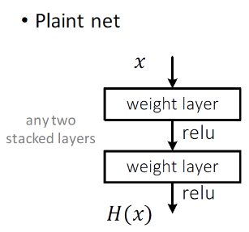
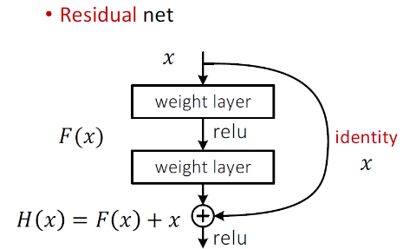
Residual Network
Plain net: transforming the input into output
ResNet: transforming what to add to input
[He et al., 2015, 2016]
Computer Vision
Notes:
Very recent works, December 2015
Resnet, transform representation of Hx
Plain net : create a function of H(x) that can map your input into output
Instead to transform your input to Hx, you compute what to add to your input
Resnet: create a function of F(x) that can be added to your input, that can map the input to output
So it calculate delta representation on top of input, instead calculating new representation of inputs

Slide 14
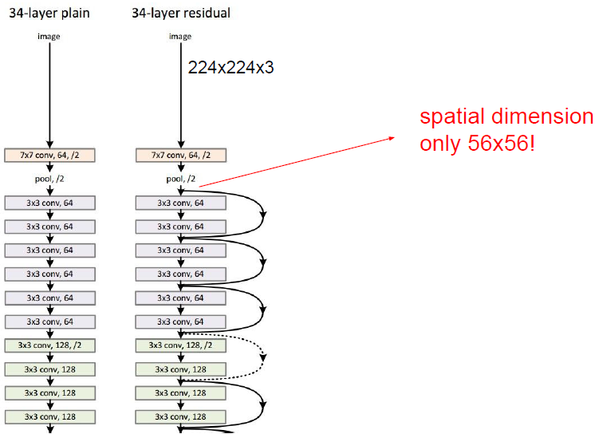
Residual Network
Forward: input data can be retained in higher layer
Backward: Gradient can flow back right to input
[He et al., 2015, 2016]
Computer Vision
Notes:
On first conv, reduce spatially by huge factor into 56x56, the latter 150 layers use 56x56 volume
Forward: input data can be retained in higher layer
Backward: Gradient can flow back right to input
[2016] Identity Mappings in Deep Residual Networks

Slide 15
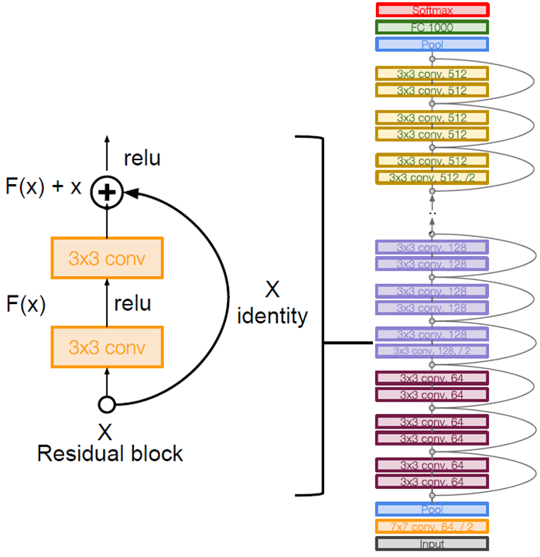
ResNet Details
Use the same aggressive stem as GoogLeNet to downsample input by 4
Stack residual blocks
Every residual block has two 3x3 conv layers
Periodically, double the number of filters and down sample spatially using stride 2 (halves in each dimension)
[He et al., 2015, 2016]
Computer Vision
Notes:
Alexnet: 0.01, higher net because of batch norm
No dropout, because using batch norm
[2016] Identity Mappings in Deep Residual Networks

Slide 16
ResNet Details
Additional conv layer at the beginning
No FC layers at the end (only FC 1000 to output classes)
Global average pooling layer after last conv layer
No use of Pooling
[He et al., 2015, 2016]
Computer Vision
Notes:
Alexnet: 0.01, higher net because of batch norm
No dropout, because using batch norm
[2016] Identity Mappings in Deep Residual Networks

Slide 17
ResNet Details
Training
Batch Normalization after every CONV layer
Xavier/2 initialization from He et al.
SGD + Momentum (0.9)
Learning rate: 0.1, divided by 10 when validation error plateaus
Mini-batch size 256, Weight decay of 1e-5
No dropout used
Total depths of 34, 50, 101, or 152 layers for ImageNet
[He et al., 2015, 2016]
Computer Vision
Notes:
Alexnet: 0.01, higher net because of batch norm
No dropout, because using batch norm
[2016] Identity Mappings in Deep Residual Networks

Slide 18
ResNet-50
50 layers
Input 224x224x3
Conv 64 (7x7, s=2), MaxPool (3x3, s=2)
3x Residual Layer A
4x Residual Layer B
6x Residual Layer C
3x Residual Layer D
Dense 1000
1 Residual Layer = 3 Layer Conv (3-1-3)
[He et al., 2015, 2016]
Computer Vision

Slide 19
ResNet-152
50 layers
Input 224x224x3
Conv 64 (7x7, s=2), MaxPool (3x3, s=2)
3x Residual Layer A
8x Residual Layer B
36x Residual Layer C
3x Residual Layer D
Dense 1000
1 Residual Layer = 3 Layer Conv (3-1-3)
[He et al., 2015, 2016]
Computer Vision

Slide 20
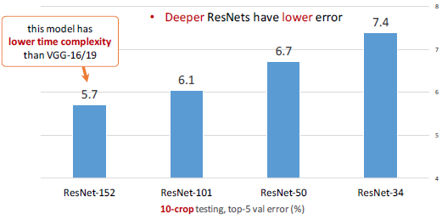
ResNet on ImageNet
[He et al., 2015, 2016]
Computer Vision
Notes:
[2016] Identity Mappings in Deep Residual Networks

Slide 21
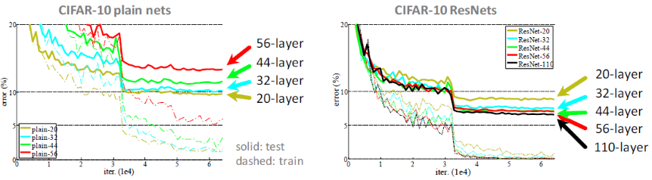
Residual Network
Deeper ResNets have lower training error, and also lower test error
[He et al., 2015, 2016]
Computer Vision
Notes:
general phenomenon, observed in many datasets
[2016] Identity Mappings in Deep Residual Networks

Slide 22
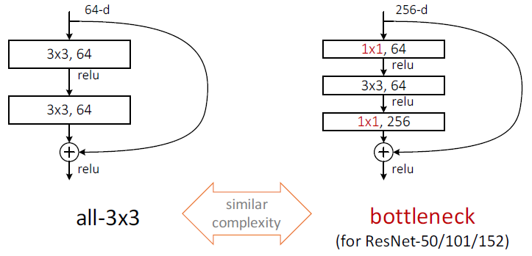
Residual Network: Bottleneck Block
A practical design of going deeper (50+ layers)
[He et al., 2015, 2016]
Computer Vision
Notes:
ILSVRC 2015 winner (3.6% top 5 error)
Slide from Kaiming He’s recent presentation https://www.youtube.com/watch?v=1PGLj-uKT1w
[2016] Identity Mappings in Deep Residual Networks

Slide 23
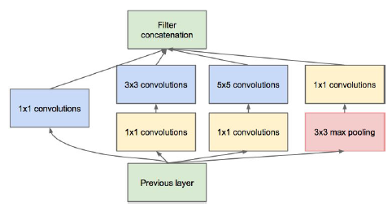
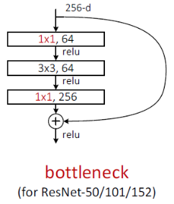
Residual Network
This trick also used in GoogLeNet
Computer Vision
Notes:
[2016] Identity Mappings in Deep Residual Networks

Slide 24
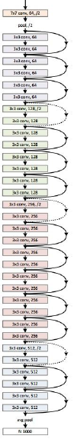
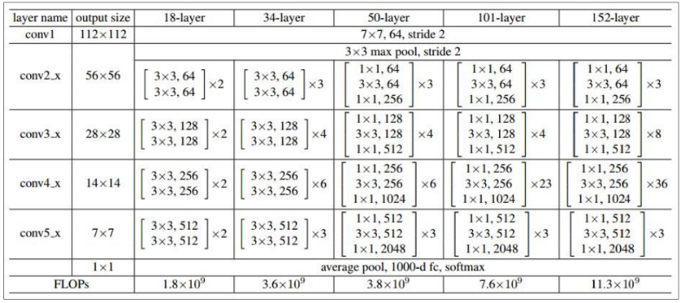
Residual Network
[He et al., 2015, 2016]
Computer Vision
Notes:
[2016] Identity Mappings in Deep Residual Networks

Slide 25
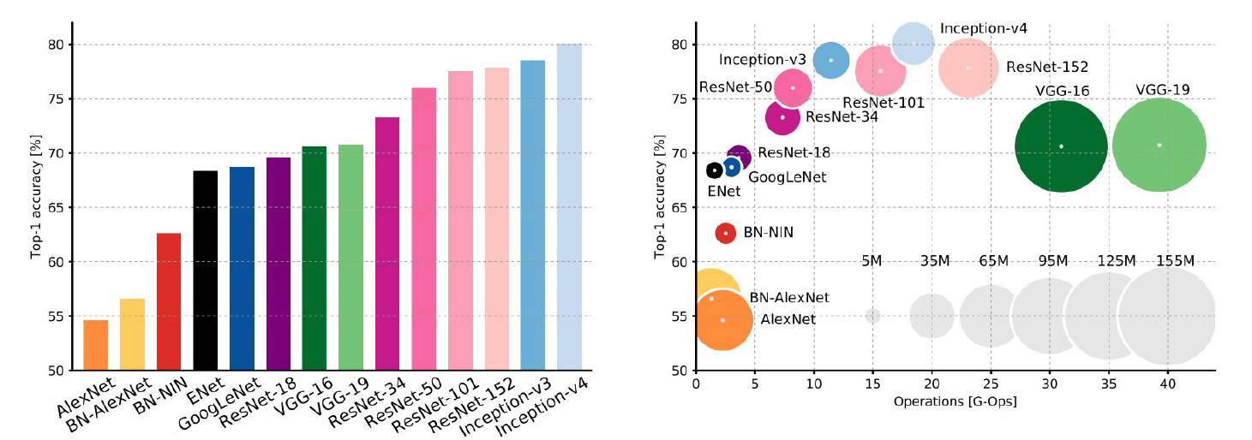
Comparing Complexity
Inception-v4: Resnet + Inception!
Computer Vision
Notes:
S-S-8-8-19-22-152-152-152

Slide 26
ResNet
Pretraining available
Total parameters
25M (ResNet-50)
60M (ResNet-152)
compared to AlexNet 62M
Model size
100MB (ResNet-50)
232MB (ResNet-152)
[He et al., 2015, 2016]
Computer Vision

Slide 27
Comparing Complexity
ResNet:
Moderate efficiency depending on model, highest accuracy
VGG: Highest memory, most operations
GoogLeNet:
Most Efficient
AlexNet:
Smaller compute, still memory heavy, lower accuracy
Computer Vision
Notes:
S-S-8-8-19-22-152-152-152

Slide 28
ILSVRC 2016 - Winners
September 26th 2016
Computer Vision

Slide 29
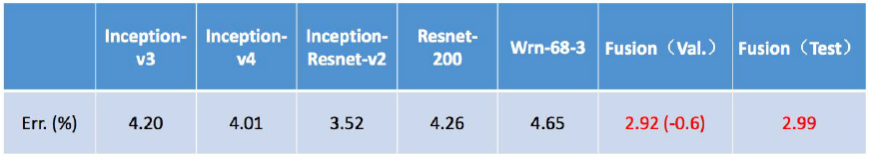
Winner 2016: Trimps-Soushen Ensembles
Good Practices for Deep Feature Fusion
5 ensembles contested (4 win)
Classification error: 0.02991 - 0.03144
Multi-scale Ensembles of ResNet, Inception, Inception-Resnet, Wide ResNet, etc.
http://image-net.org/challenges/LSVRC/2016/results
26 September 2016
[Shao et al. 2016]
Computer Vision

Slide 30
2nd Winner 2016: ResNeXt
Aggregated Residual Transformations for Deep Neural Networks
Classification error: 0.03031
Also from creators of ResNet
Increases width of residual block through Modularized multi-way extension of ResNet (“cardinality”)
Parallel pathways similar in spirit to Inception module
[Xie et al. 2016]
Computer Vision

Slide 31
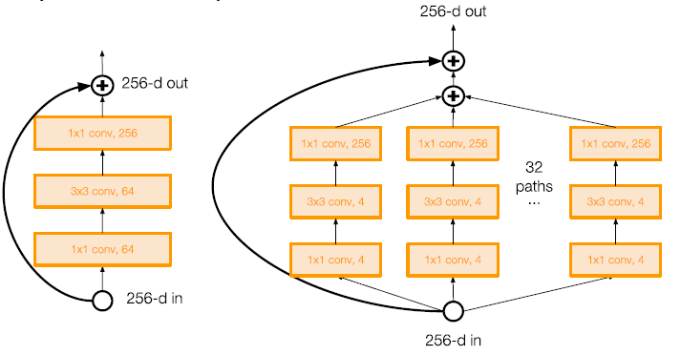
2nd Winner 2016: ResNeXt
[Xie et al. 2016]
Computer Vision

Slide 32
ILSVRC 2017 - Winners
July 17th 2017
Computer Vision

Slide 33
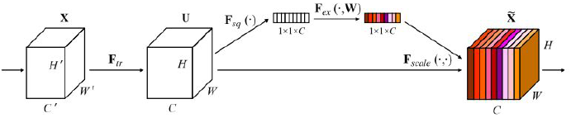
Winners 2017: SENet
BDAT [Hu et al. 2017]
Squeeze-and-Excitation Networks (SENet)
Adaptive attention and deep combined convolutional models
Classification error: 0.023
Adaptive feature map reweighting.
http://image-net.org/challenges/LSVRC/2017/results
Computer Vision

Slide 34
Squeeze-and-Excitation Networks
Add a “feature recalibration” module that learns to adaptively reweight feature maps
Global information (global avg. pooling layer) + 2 FC layers used to determine feature map weights
Using ResNeXt-152 as a base architecture
http://image-net.org/challenges/LSVRC/2017/results
Computer Vision

Slide 35
Completion of the challenge: Annual ImageNet competition no longer held after 2017, now moved to Kaggle
Computer Vision

Slide 36
Beyond 2016…
Computer Vision

Slide 37
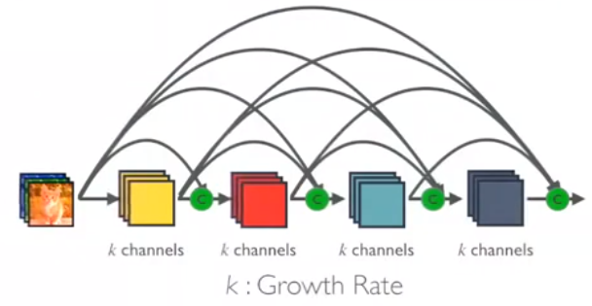
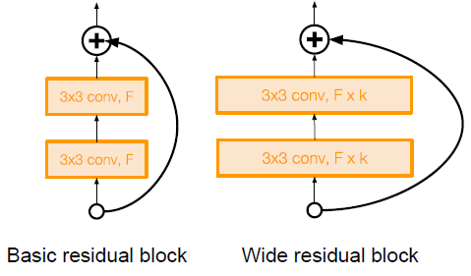
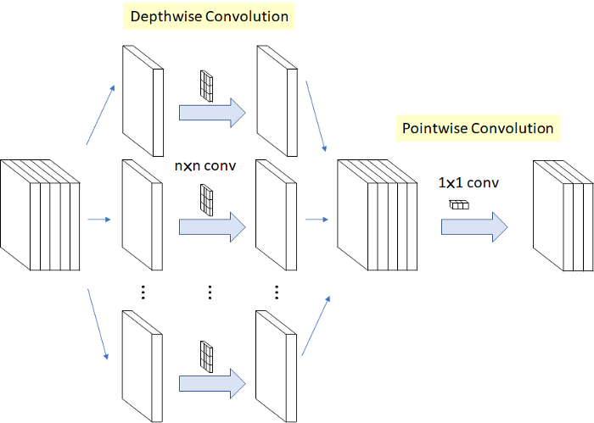
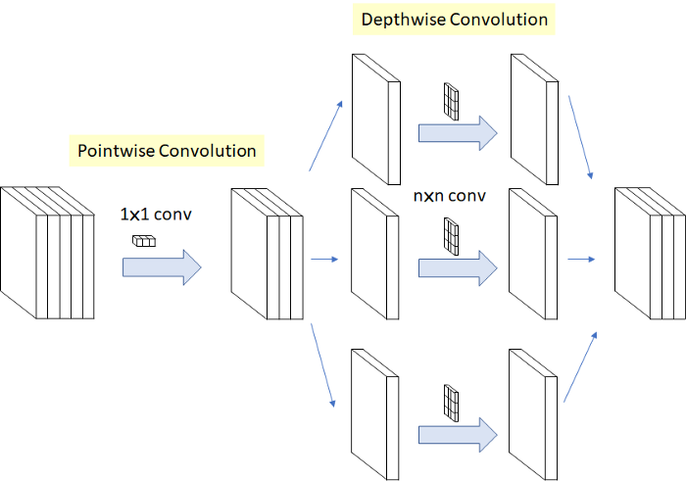
Beyond 2016…
Swapout
Wide-Resnet
Fractal Net
Dense Net
MobileNet
Xception
ShuffleNet
NAS
…
Computer Vision

Slide 38
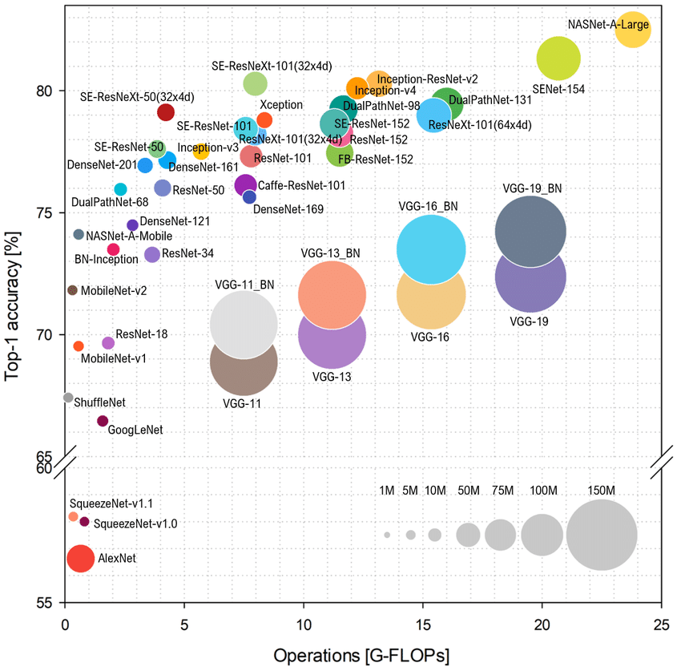
Computer Vision
Notes:
S-S-8-8-19-22-152-152-152

Slide 39
Summary
Computer Vision

Slide 40
TL;DR
Architecture
Early: stack CONV, POOL, FC layers, bigger is better
Recent: complex architecture
Trend towards smaller filters and extremely deeper architectures
Recent: more shallow with wider filters
Trend toward getting rid of POOL/FC layers
Less parameters, just using CONV
Computer Vision

Slide 41
TL;DR
Trend toward using more ensembles of many different type of layers
Many other aspects of network architectures are also continuously being investigated and improved
After ResNet: Efficient networks became central:
how can we improve the accuracy without increasing the complexity?
Lots of tiny networks aimed at mobile devices: MobileNet, ShuffleNet, etc
Neural Architecture Search promises to automate architecture design
Computer Vision

Slide 42
TL;DR
Significant research centers around design of layer / skip connections and improving gradient flow
Efforts to investigate necessity of depth vs. width and residual connections
More recent trend towards meta-learning
Even more recent trend towards weight-agnostic neural net
Computer Vision

Slide 43
TL;DR – don’t be a hero
What architecture to use?
Take whatever works best, Download pretrained model
Potentially add/delete some parts of it
Finetune it
VGG, GoogLeNet, ResNet all in wide use, available in model zoos
ResNet and SENet are current best default
MobileNet and ShuffleNet for small efficient network
Computer Vision

Slide 44
TL;DR – don’t be a hero
What hyperparameters to use?
Use whatever is reported to work best
Play with regularization strength/dropout rates
Tune learning rate a little (but don’t be too crazy)
Computer Vision

Slide 45
TL;DR – Pretrained Models
Model | Size | Top-1 Accuracy | Top-5 Accuracy | Parameters
Xception | 88 MB | 79 | 94.5 | 22.9M
VGG16 | 528 MB | 71.3 | 90.1 | 138.4M
VGG19 | 549 MB | 71.3 | 90 | 143.7M
ResNet50 | 98 MB | 74.9 | 92.1 | 25.6M
ResNet101 | 171 MB | 76.4 | 92.8 | 44.7M
ResNet152 | 232 MB | 76.6 | 93.1 | 60.4M
ResNet50V2 | 98 MB | 76 | 93 | 25.6M
ResNet101V2 | 171 MB | 77.2 | 93.8 | 44.7M
ResNet152V2 | 232 MB | 78 | 94.2 | 60.4M
InceptionV3 | 92 MB | 77.9 | 93.7 | 23.9M
InceptionResNetV2 | 215 MB | 80.3 | 95.3 | 55.9M
MobileNet | 16 MB | 70.4 | 89.5 | 4.3M
MobileNetV2 | 14 MB | 71.3 | 90.1 | 3.5M
DenseNet121 | 33 MB | 75 | 92.3 | 8.1M
DenseNet169 | 57 MB | 76.2 | 93.2 | 14.3M
DenseNet201 | 80 MB | 77.3 | 93.6 | 20.2M
NASNetMobile | 23 MB | 74.4 | 91.9 | 5.3M
NASNetLarge | 343 MB | 82.5 | 96 | 88.9M
Computer Vision

Slide 46

Question?
Computer Vision

Slide 47

Next Agenda
Visualization and Understanding
Computer Vision

Slide 48
References
Yogesh Singh Rawat – CAP5415 Lectures, University of Central Florida
David Fouhey – EECS442 Lectures, University of Michigan
Grauman, K. and Leibe, B. 2011. Visual Object Recognition. Synthesis Lectures Artif. Intell. Mach. Learn. 5, 1 181
Computer Vision

